Slide 1
Defending Against Phishing Attacks
The Invisible Hook
Every day, millions of phishing attempts go out across the globe. Most succeed not because of weak software but because of human trust. This module will equip you to recognize, resist, and report every attempt.

Slide 2
What is phishing?
Phishing is a cyber scam where attackers try to trick people into sharing passwords, OTPs, bank details, or other private information. It often looks like a normal email, message, or website, but it is actually fake.
Attackers exploit four core emotions: Curiosity, Greed, Fear, and Authority. Understanding these triggers is your first line of defense.

Slide 3
Why phishing is dangerous?
Phishing can leads to:
Money loss
Stolen passwords
Hacked accounts
Identity theft
Malware infection

Slide 4
How to recognize phishing?
Look for these warning signs:
Unknown or suspicious sender.
Urgent messages like “your account will be blocked.”
Spelling and grammar mistakes.
Strange or shortened links.
Requests for OTPs, passwords, or payment.

Slide 5
Understanding Social Engineering
Attackers use psychology to trick people. (They may create)
Fear
Urgency
Curiosity
Reward offers
Fake authority
Their goal is to make you act without thinking.

Slide 6
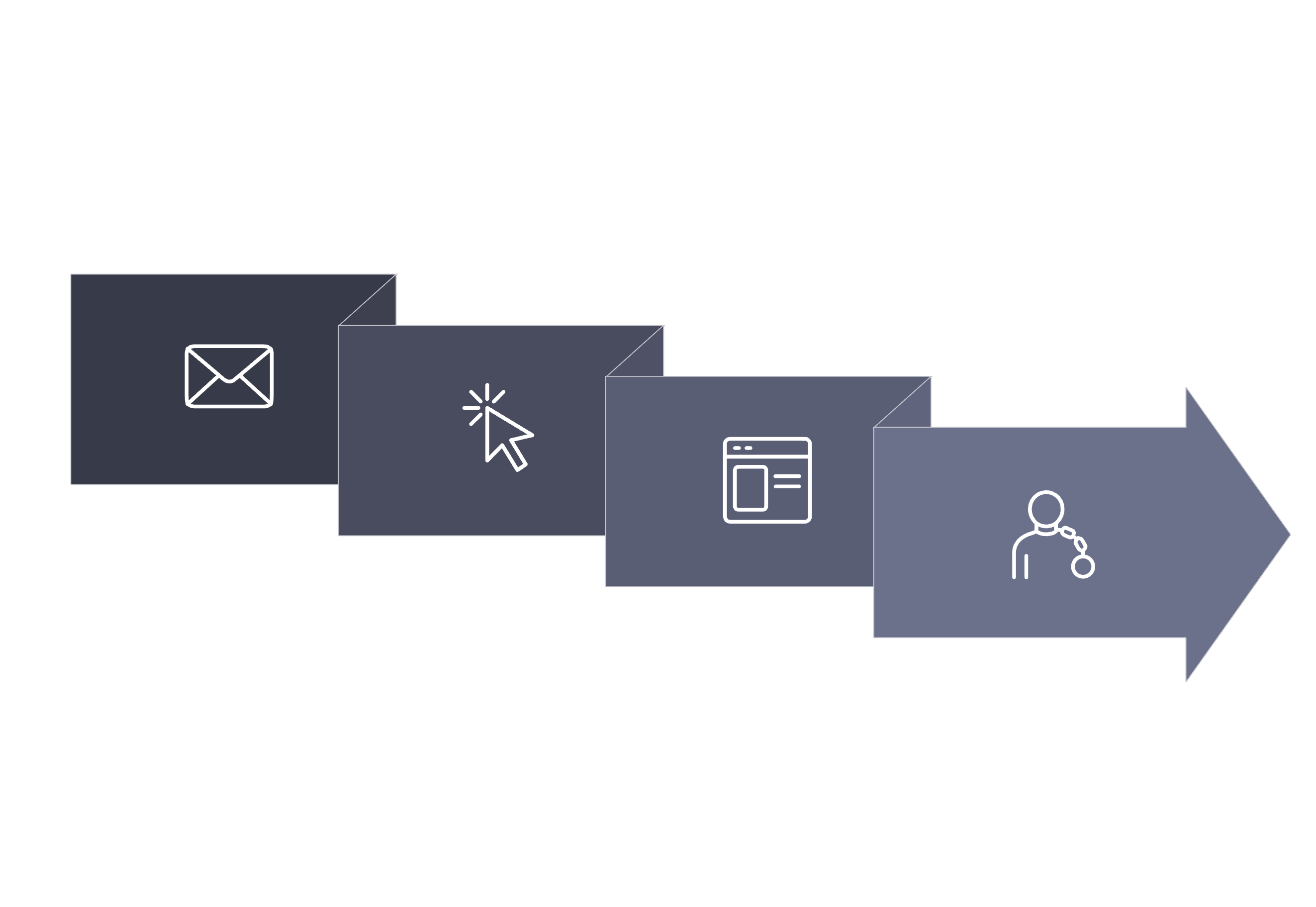
Anatomy of a Phishing Attack
The Hook
The Strike
The Bait
The Trap
Every phishing attack follows a predictable pattern.
Recognizing each stage from the initial bait to the final strike gives you the power to
break the chain before damage is done.

Slide 7
How to identify Fake websites?
Use names that look very similar to real brands.
Have unusual URLs.
Ask for login details immediately.
Show poor design or broken pages.
Have no proper security or contact information.

Slide 8
How to stay safe?
Follow these rules:
Do not click suspicious links.
Check the sender carefully.
Visit websites directly instead of using message links.
Never share OTPs or passwords.
Use strong passwords.
Turn on two-factor authentication.

Slide 9
Conclusion
Phishing is one of the most common cyber threats. Careful checking, safe browsing habits, and strong passwords can protect users from many attacks.

Slide 10

Quiz
What is phishing?
Name one sign of a fake email.
Should you share OTPs with anyone?
What should you do before clicking a link?
Why do attackers use urgency in messages?

